Slide 1
Battle of the Neighborhoods Capstone Project

Slide 2
Project analysis slide 2
Introduction
New York City has the biggest Chinese populace of any city outside of Asia and inside the U.S. with an expected populace of 573,388 out of 2014 and keeps on being an essential goal for new Chinese settlers. New York City is subdivided into authority civil districts, which themselves are home to critical Chinese populaces, with Brooklyn and Queens, nearby situated on Long Island, driving the quickest development. After the City of New York itself, the districts of Queens and Brooklyn envelop the biggest Chinese populaces, individually, of all regions in the United States.

Slide 3
Project analysis slide 2
Objective
Need to distinguish sustenance propensities for the general population remaining in individual areas. We will examine the present cafés execution by utilizing evaluations.
To investigate this we are going to list and envision every significant piece of New York City that has extraordinary Chinese eateries. We will discover the potential areas which has great measure of Chinese cafés.
Going to consider evaluations of those cafés to bring bits of knowledge of how great those eateries was. The outcomes will be plotted on guide for better understanding.

Slide 4
Project analysis slide 2
Project Analysis
Gather Data
Pre-process
PROJECT
Visualize
DESIGN
Implement
DEVELOP

Slide 5
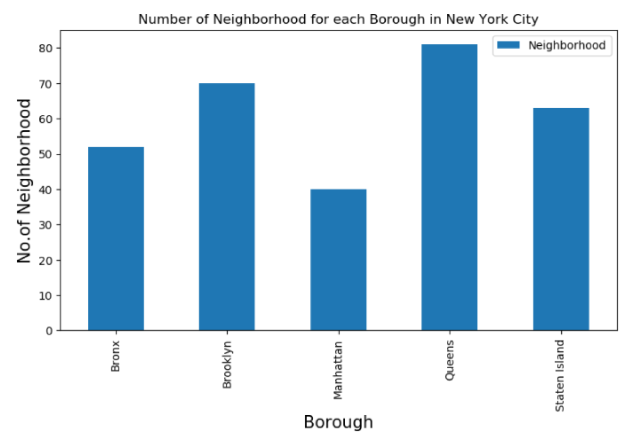
Project analysis slide 4
Neighborhood Analysis
To start we needed to identify the number of neighborhoods in each of the NYC boroughs.
From the result set show, we can see the Queens has the highest number of neighborhoods.

Slide 6
Project analysis slide 4
Neighborhood Analysis
Queens also managed to have the highest number of Asian restaurants in the in the borough.
Although that still does not mean Queens is the most optimal location for opening up a new branch

Slide 7
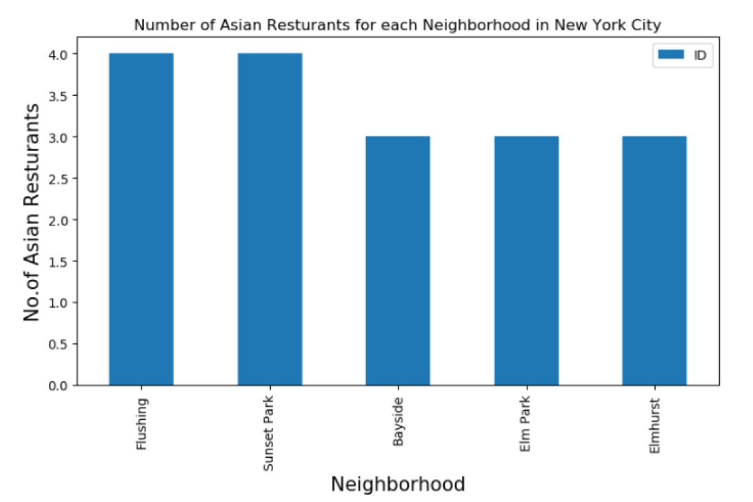
Project analysis slide 4
Neighborhood Analysis
Diving deeper into the borough to look into the neighborhoods, we can see that “Flushing” & “Sunset Park” both have the an almost equal number of Asian cuisines.
**Note : Data shown varied based on the number of API calls made during the day.

Slide 8
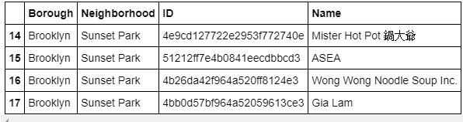
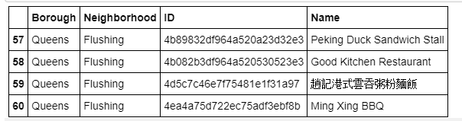
Project analysis slide 4
Neighborhood Analysis
Though not the most accurate measure, the restaurant names do give an indication of the type of Cuisine.

Slide 9
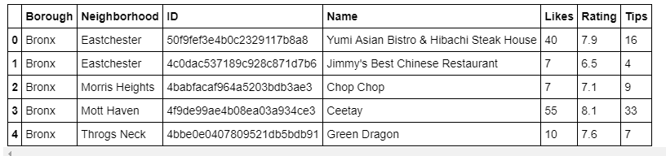
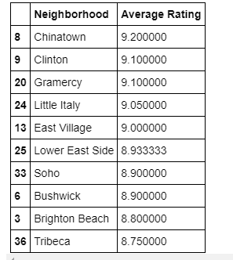
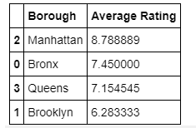
Project analysis slide 4
Foursquare Analysis
A call to the API is then made to identify the Likes, Ratings and Tips for each restaurant.
This can give the customer more insight. An average rating is then given to the neighborhood.

Slide 10
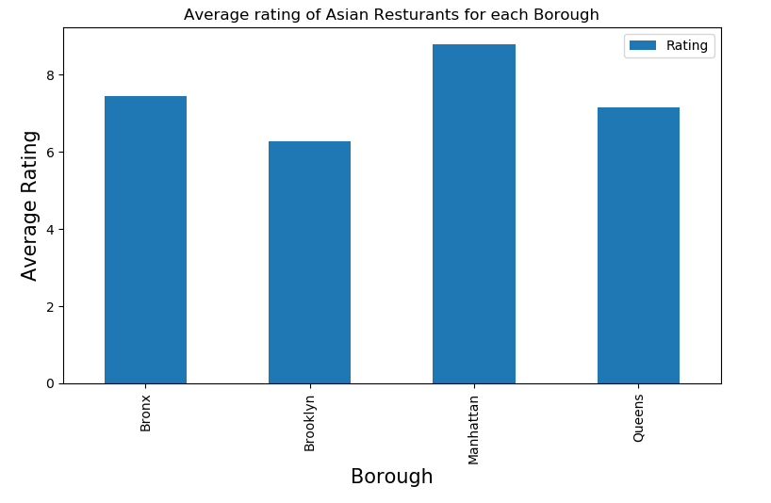
Project analysis slide 4
Foursquare Analysis
The result set is then displayed onto a graph showing the average ratings per Borough.
As we can see, despite Queens having the most restaurants earlier, Manhattan still has better ratings when it comes to their restaurants.

Slide 11
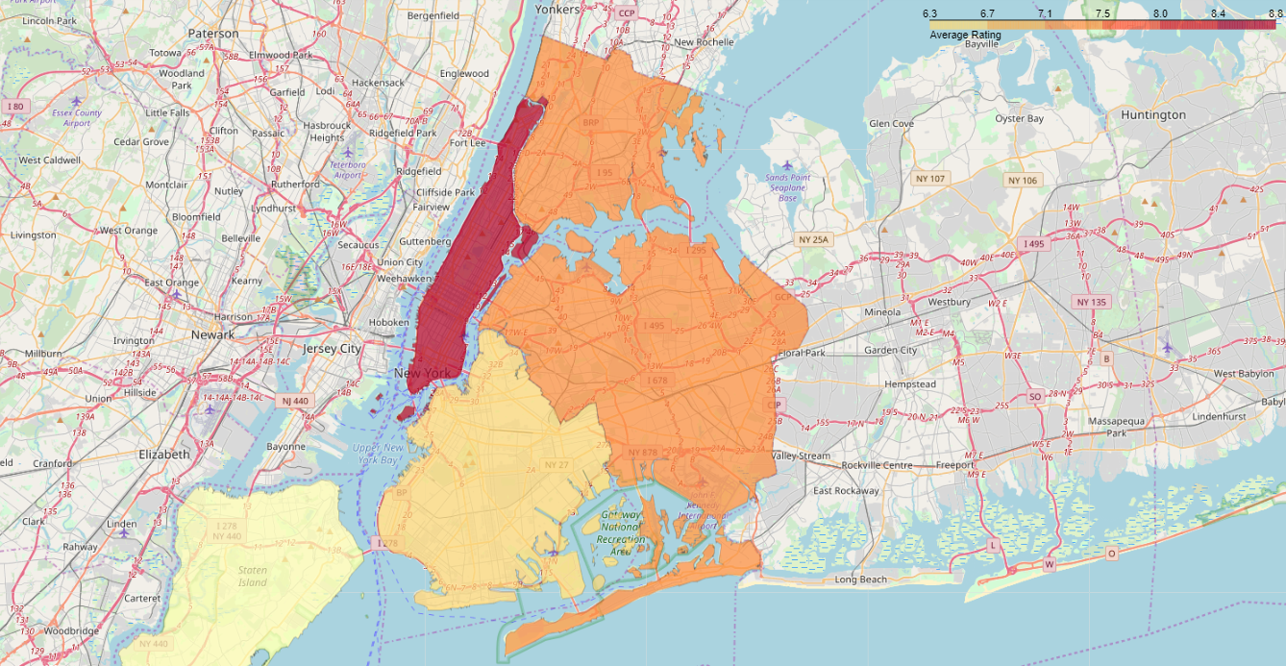
Project analysis slide 6
Visualization

Slide 12
Project analysis slide 6
Conclusion
A folium map has been generated in order to give us a better visualization on the breakdown. With Manhattan coming in as the recommended borough based on the popularity and ratings given to restaurants in those area. The Bronx and Queens also come in at a close 2nd, as other options for potential other branches.
All in all, the client can consider opening restaurants in Manhattan based on the popularity of ratings within that borough. Having to open on the outskirts towards Queens and The Bronx, can help target audience from those boroughs.

Slide 13
Project analysis slide 8
Project Analysis
POSITIVE
NEGATIVE
STRENGTH
WEAKNESS
The customer would be able to surround himself with other Asian restaurants within the area and target the necessary population.
The analysis only performs checks based on ratings of the restaurants and the study of population within those areas' neighborhoods
OPPORTUNITY
THREAT
Taking into consideration age, restaurant pricing and other factors can help narrow down even further the result set.
Crime rates were not taken into consideration when performing this analysis. This could skew the results in terms of deciding when to open a new branch.

Slide 14
Thank You

